Slide 1
CSE 306
System Analysis & Design Lab

Slide 2

Submitted by
SUBMITTED TO
NAME: SHEIKH NAFEZ SADNAN ID: 20101106 SECTION: B SEMESTER: 3-1 DEPT: CSE
ALI ZAFAR SADIQ LECTURER DEPARTMENT OF CSE UNIVERSITY OF ASIA PACIFIC

Slide 3

MATRIMONY PROJECT (SAMPLE SCENARIO)

Slide 4
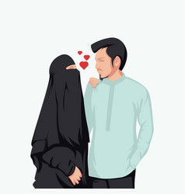
PROJECT PURPOSE
The core purpose of this matrimonial website project is to find perfect matches. Here, users can upload their biodata to find a suitable match for them. Also they can seek for their desired person by a optimized search option.

Slide 5
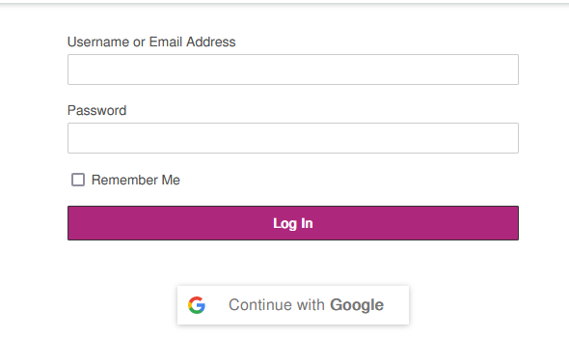
Log in/sign up interface
Existing users have to "Log In" using their username, email ID, or phone number and password. New users can use the "Sign Up" option to register for a new account by providing some personal information and a phone number or email verification.
Fig. 01: Sample log in Interface

Slide 6
Creating biodata
After a successful log in, a user can create their own biodata by providing detailed information. This includes personal information, family information, educational qualifications, address, contact details etc. After successfully giving the requested information, the user has to agree to terms and conditions to complete his biodata. Terms and conditions include: Introduction. Right to make changes to the agreement. User guidelines. (rules, restrictions, requirements) Copyright and intellectual property information. Governing law. Privacy information. Limitation of liability.

Slide 7
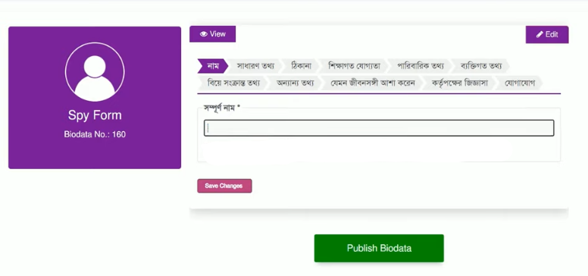
Fig. 02: Sample biodata form Interface

Slide 8
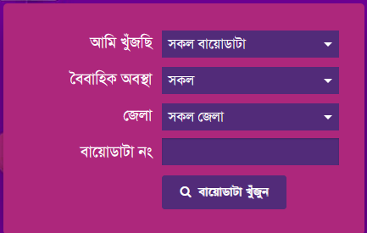
searching biodata
To search for biodata, users can search by their desired options to get the specific results. This includes options like-search by gender, marital status, district, and biodata no.
Fig. 03: Sample search box Interface

Slide 9
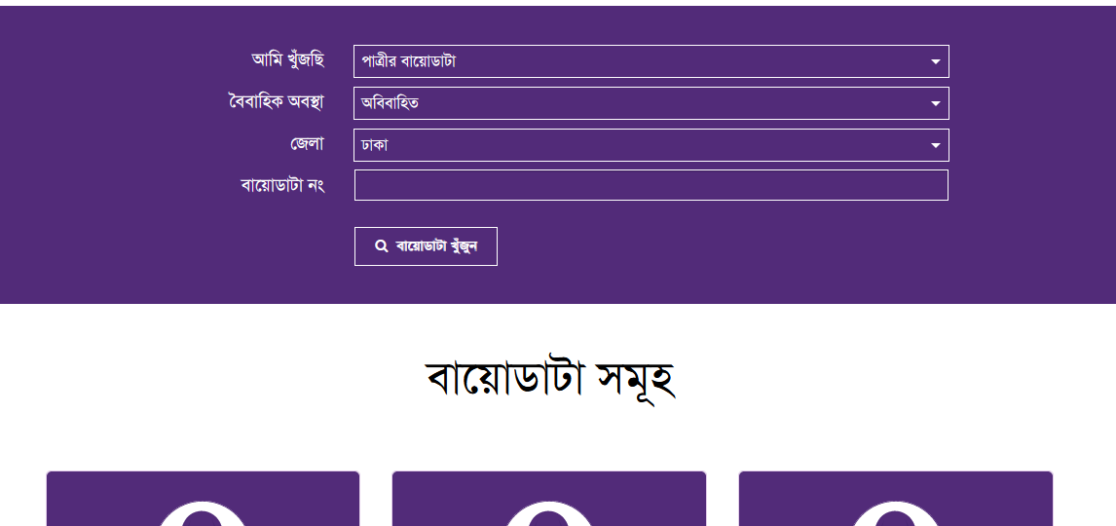
Search results
Fig. 04: Sample search result Interface

Slide 10
AVAILABLE OPTION’S
Home Page with search option and log in
About Us
FAQ’S
Tutorial (User Manual)
Contact Us

Slide 11
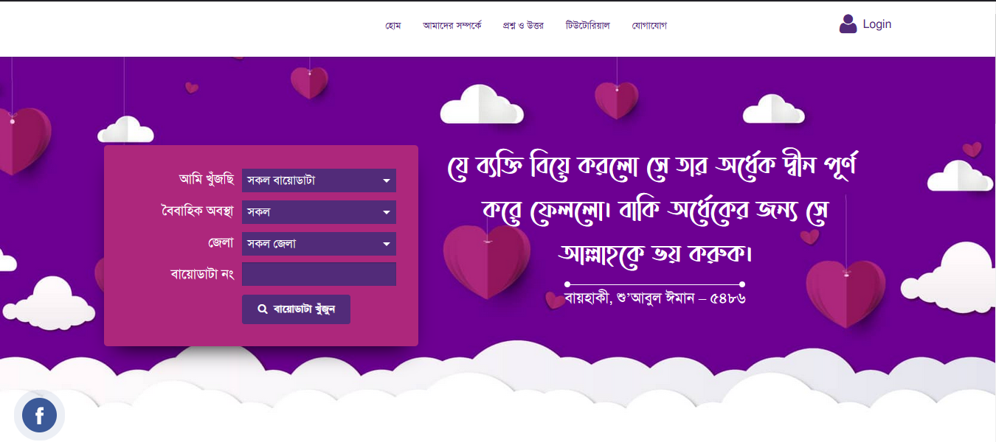
Fig. 05: Sample home page Interface

Slide 12
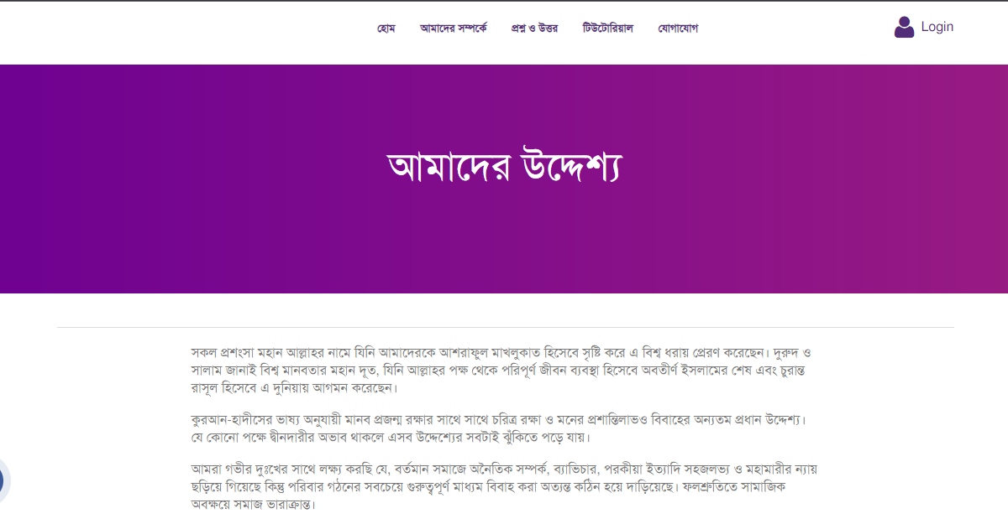
Fig. 06: Sample about us Interface

Slide 13
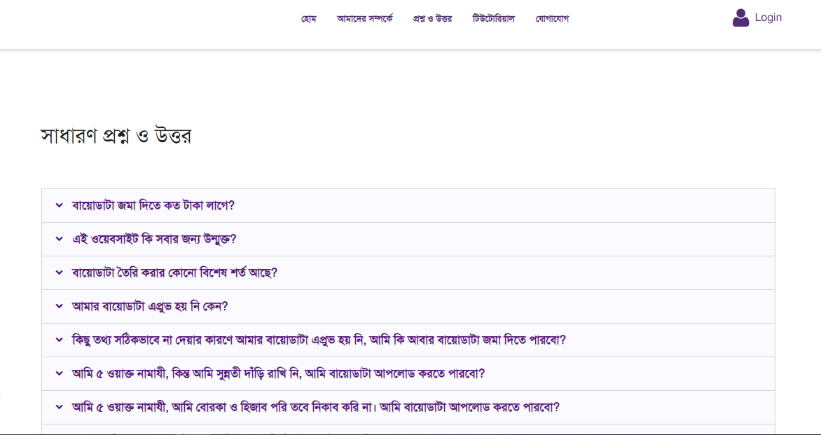
Fig. 07: Sample FAQ Interface

Slide 14
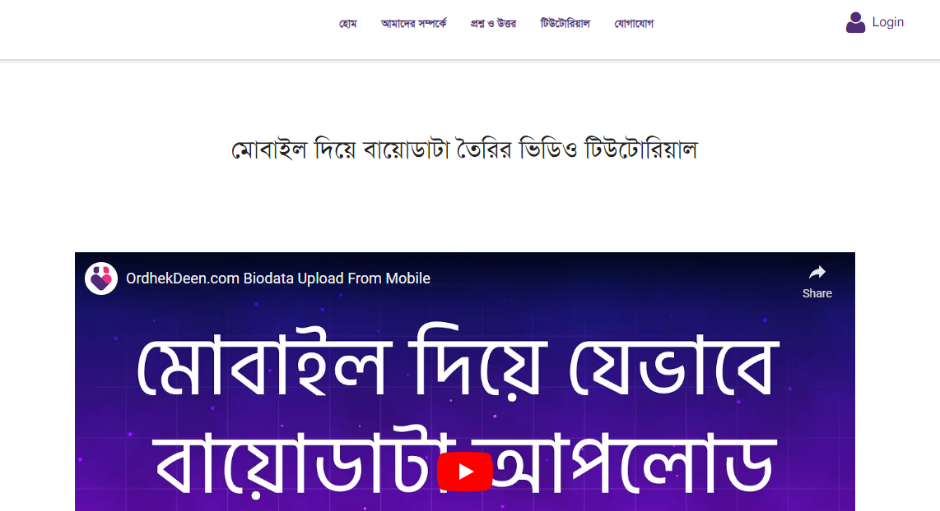
Fig. 08: Sample tutorial Interface

Slide 15
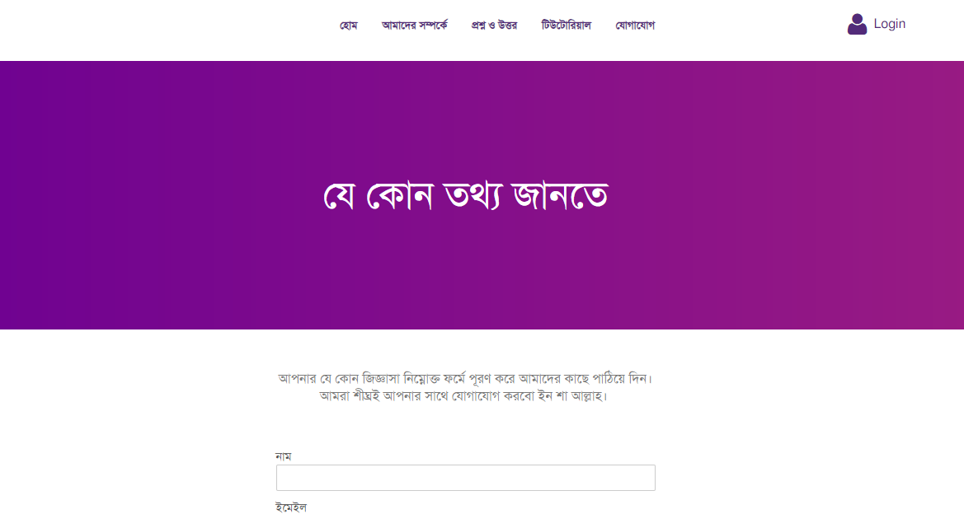
Fig. 09: Sample contact us Interface
* Reference = https://ordhekdeen.com

Slide 16
Thank You All

